Slide 1
Astronomically Tuning Color Variations in Core Images for Use as Paleoenvironmental, Paleoclimate, and Chronostratigraphy Proxies
Peter Flaming
Brandon De La Houssaye
Quinton Nixon
Gary Acton, PhD

Slide 2
Overview
Modeling Color Variation Data (RGB and L*)
Core Photos Used
IODP Expedition 320 Site U1333
Color Space Decisions
Region of Interest (ROI)
RGB values
L* values
Analysis Methods
Machine Learning Applications
Deep Learning Applications
Geoscience Significance
Paleoenvironmental
Paleoclimate
Chronostratigraphic

Slide 3
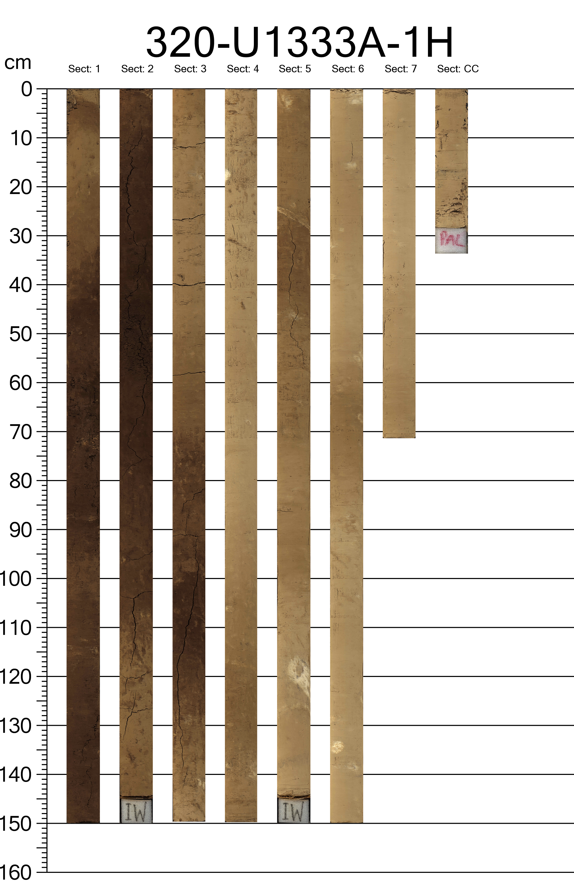
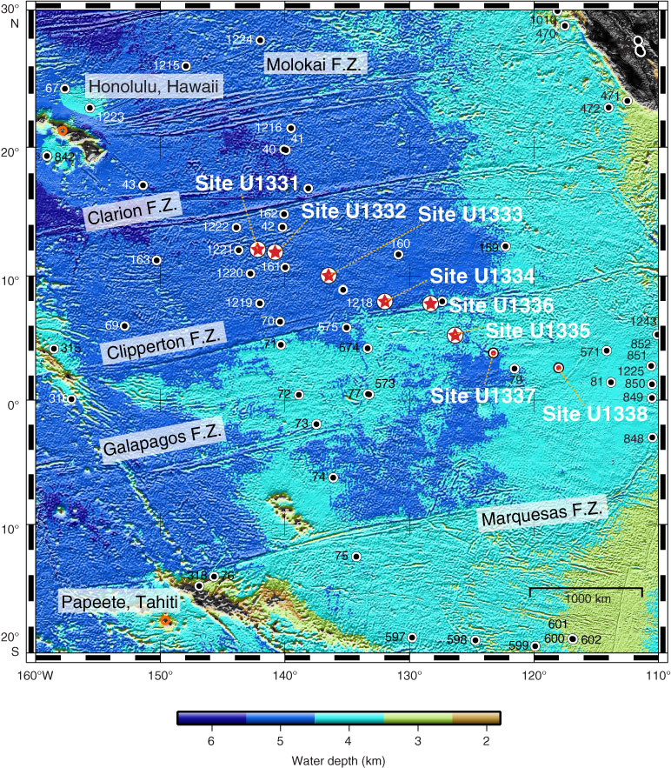
IODP Expedition 320 Site U1333
A total of 66 cores culminating in 531.25 mbsf were collected across three holes 4,858 meters below the ocean surface in the Pacific Ocean.

Slide 4
Site U1333A Core Image Preprocessing
First we calibrate the image pixels using the gray card to correct for light variations across core photo.
Second we select the Region of Interest (ROI) across each core photo for preprocessing and pixel value extraction.
Lastly we select the best pixels within the ROI across each core photo for analysis.

Slide 5
Hacking the Slide Format
Hacking the slide format is allowed
However,
The total number of slides
must be 21
The slides must transition automatically every 15 seconds
The aspect must be the standard format (not 16:9)
The footer information must be present and in the same position as this template

Slide 21
Last Slide
Fade to black after 15 seconds

